Slide 1
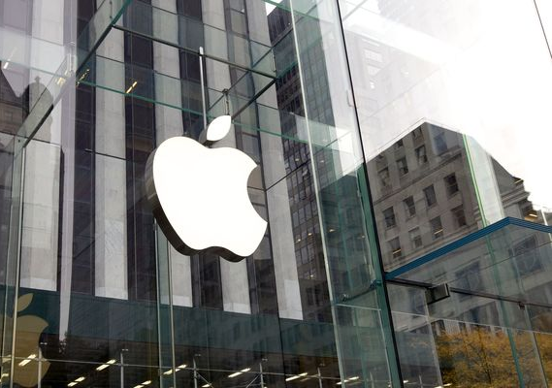


APPLE
AAPL
Recommendation: Buy
Closed: Apr 14 - 165.29 USD
Mingze Lin
Notes:
Report: https://docs.google.com/document/d/1bVCGfBTiSR5cdENwc-4X8FTTwhajd-m0JANzYwCf-AI/edit

Slide 2

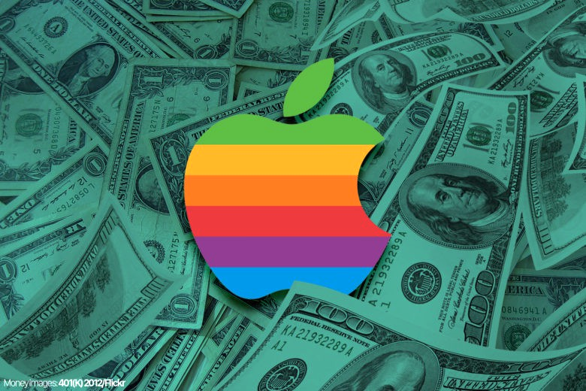
Investment Hypothesis
We believe Apple is a great investment due to the following advantages:
Strong pricing power (to outperform the market by raising profit margin)
Being a large and profitable company with healthy CF
These qualities are useful if the economy runs into a recession, as interest rates rise.
Besides, we argue Apple has sustainability, competitive advantages, strong fundamentals, and growth potentials.
Also, the current price seems reasonable.

Slide 3
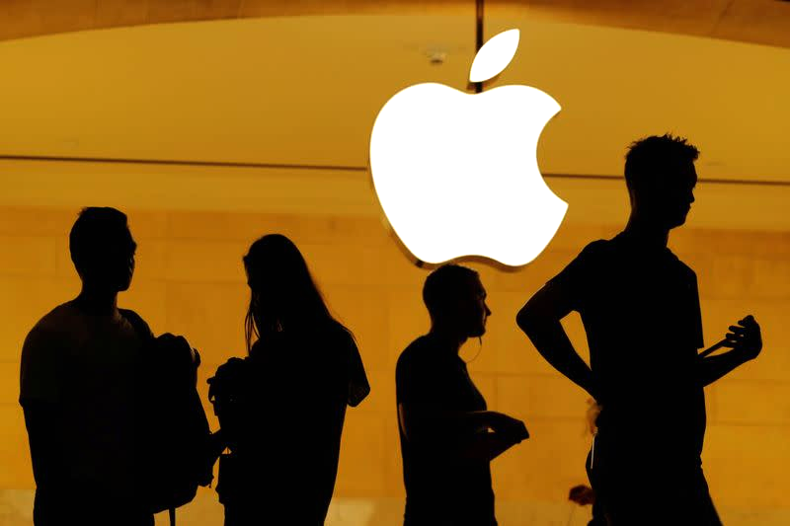
Investment Hypothesis
In particular, strong pricing power base on:
The scarcity or monopolistic status of a product - Ecosystem
The product is a necessity - Lockin relations
The product can increase productivity, which offsets the change in price - ease of use
Apple have them all.
Notes:
With a closer look, Apple’s product and service satisfies all three criteria. The IOS App Store is nearly monopolistic to anyone who uses iPhone, iMac, etc. Meanwhile, study shows Apple’s products can boost business productivity. But most importantly, Apple has the highest consumer loyalty rate, and to some, Apple’s products are necessities.

Slide 4




PEST Analysis
Factor1: China zero covid lockdown triggers global supply chain issues, e.g. chip shortage, fueling inflation.
Factor2: Russia-Ukraine war leads to unstable energy supply, raising commodity price and inflation.
Political
Worsen the ongoing inflation
Factor3: FED plans on tapering and increasing interest rate, but it will take time to curb inflation.
Economic
Negative for the stock market in the short term
Factor4: Consumer-Tech overall may decline in 2022 due to excessive consumption during Covid-19 lockdown period.
Social
Negative for demand from the consumer electronics industry
Factor5: Tech giants are betting on the metaverse.
Technological
Potential Singularity for Innovation and Revenue Growth
Notes:
For the first part, let’s start with the PEST analysis, as shown in Table1. Put together, Factor1 and 2 could worsen the ongoing inflation, and stimulate FED’s schedule on tapering and raising interest rate, i.e. Factor3, which is negative for the stock market, at least in the short run. Having Factor 1, 2 and 3 occurring at the same time could be the start of a recession, or even stagflation, as some analysts suggest.

Slide 5
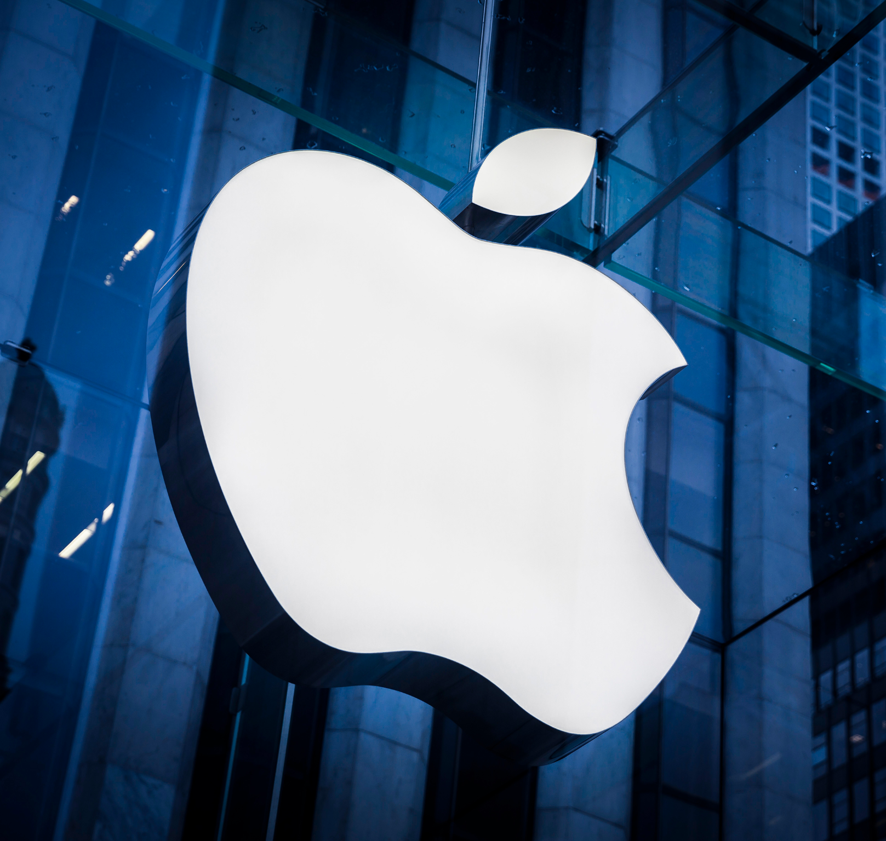
SWOT Analysis
Strength
Weakness
Brand premium - ranked 1st in Brand Finance Global 500
Supply chain management - strong bargaining power on COGS
High profit margin - continued to grow YoY since 2019
Proficient research in tech innovation
Quality Design
Consumer retention
Expensive products - target high income clients, not affordable to all
Declined sales in China - market share took over by local brands
Iphone unit sales kept declining
Incompatible with many software - IOS ecosystem is “closed end”
Slow innovation - Overreliance on iPhone, iPad, Mac, App Store, etc.
S
W
Opportunity
Threat
O
T
Supply chain disruption, chip shortage, etc.
Recession or Covid induced declined consumption, i.e. PEST Factor4
Competition from Samsung, Huawei, Xiaomi, Dell
Anti-monopoly lawsuits, regulations, and legislations
Black swan events
New products, e.g. AR/VR headsets
Growing consumer base
Use AI tech to improve products’ capabilities
New leasing models
Introduce more service - collect utilities
Notes:
In particular, Apple’s revenue could increase this year. From past experience, Apple’s revenue is highly related to its release cycle. According to sources, Apple will release the largest range of products in its history in 2022, that means Apple could break its sales record.
Besides, the greatest threat to Apple now, the supply chain disruption could be eased. As Tim Cook addressed in the latest earning call, the supply chain issues are expected to be improved. Furthermore, Apple lately won the delay in monopoly lawsuits to buy itself some time.
Last but not least, Apple’s AR/VR headsets could be a new source of growth. As PEST Factor 5 pointed out, Apple is also betting on metaverse. Unlike Facebook, Apple emphasizes the integration of VR with its already sophisticated hardware technology.
In conclusion, Apple is in a “virtuous cycle” with strong “moats”, and sustainable competitive advantages. Despite the supply chain issues remaining pressing, it may improve early this year. Thus, both PEST and SWOT analysis finds Apple a potential investment opportunity.

Slide 6








Competitive Advantage - Porter’s Five Forces Analysis
Threat of New Entry
Bargaining Power of Suppliers
Large number of component suppliers
Low switching costs for Apple
High ratio of firm concentration to supplier concentration
High cost of establishing a company
High capital requirements on R&D
Establishing brand name recognition
Competitive
Rivalry
Threat of Substitution
Bargaining Power of Buyers
Low buyer propensity to substitute
High compatibility within Apple products
Complementary Apple products
Multi Competitors: Microsoft, Google, Amazon, Samsung, Dell, Sony, Lenovo etc.
High brand loyalty in Apple ecosystem
High switching cost
Seamless sharing of contacts and stored contents
Absence of dependence on a few customers
Relatively Low
High Differentiation
Notes:
Let’s move on to have a look at Apple’s competitive advantage
Here we used Porter’s five forces analysis
Apple’s threat of new entry is pretty low
The capital requirement is high due to R&D
The brand development is also hard for the startups
company like apple, amazon, sony and samsung have already established name recognition
The threat of substitution is kind of low
Although competitors I mentioned are strong, but Apple has a high level of customer lockin, so consumers do not want to switch to other brands.
therefore
The bargaining power of buyers is low
customers have high brand loyalty in apple ecosystem
All the apple products share iCloud contents, so higher switching cost for users
Moreover,
Apple had no single customer that accounted for more than 10% of net sales in the last 3 years
This means individual customer do not have power to reduce prices or to affect Apple in any other ways.
The power of suppliers is also low
Because Apple can access many suppliers around the world, and the company have low switching cost to turn from one to another
So~overall
The firm have high competitive advantage based on five forces
Next please

Slide 7
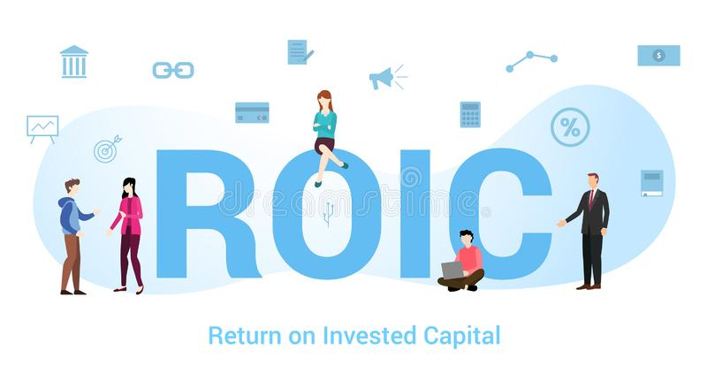
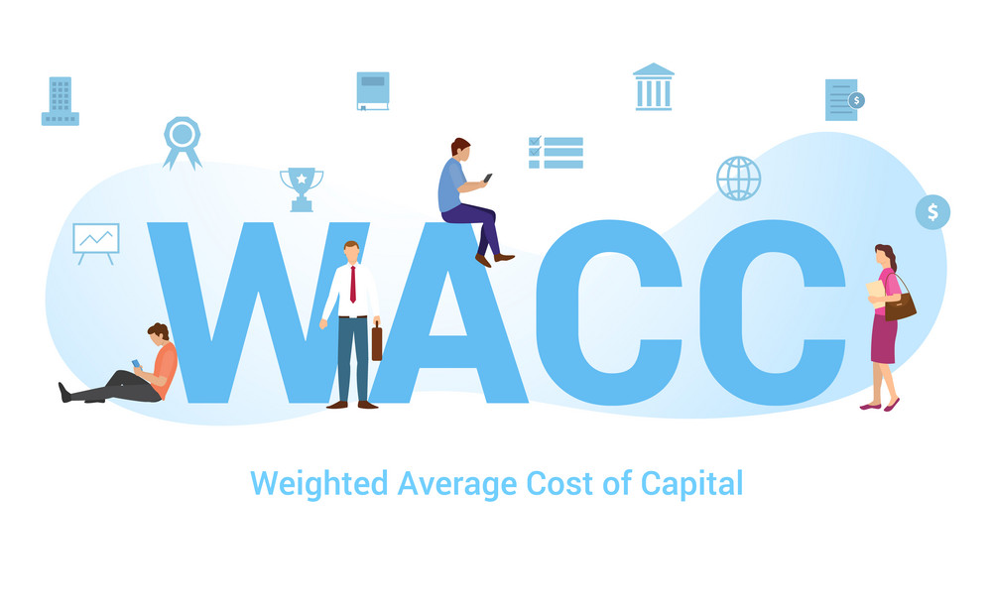


Measure of Competitive Advantage - Economic Profit
Apple ROIC: 35.38%
(calculated using TTM income statement data)
Economic Profit = 25.34%
Competitive Advantage
Apple WACC:10.04%
(As of Today)
A return on investment greater than the opportunity cost of capital
Company | ROIC | WACC | Economic Profit | 3-yr Average Revenue growth | 10-yr Average annual Total Return | PE Ratio
Apple | 35.38% | 10.04% | 25.34% | 13.75% | 22.62% | 28.26
Microsoft | 33.48% | 7.73% | 25.75% | 15.98% | 25.79% | 30.63
Alphabet(Google) | 35.67% | 8.65% | 27.02% | 23.46% | 17.31% | 23.22
Amazon | 9.33% | 7.66% | 1.67% | 26.33% | 32.02% | 48
Samsung | 12.94% | 6.56% | 6.38% | 4.64% | 10.57% | 11.55
Dell | 3.95% | 6.10% | -2.15% | 3.76% | 19.71% | 5.55
Sony | 3.19% | 4% | -0.81% | 5.18% | 17.40% | 16.42
Lenovo | 8.25% | 6.26% | 1.99% | 12.18% | 2.75% | 8.1
High Economic
Profit
Steady Revenue
Growth
Notes:
Next
Apple’s ROIC is 35% and WACC is 10% So the economic profit is 25% Today.
In consumer electronics industry, apple has one of the highest economic profit, and stable revenue growth.
On the last column, the PE ratio for Apple, in comparison, is not cheap, but it is reasonable.
Next please

Slide 8
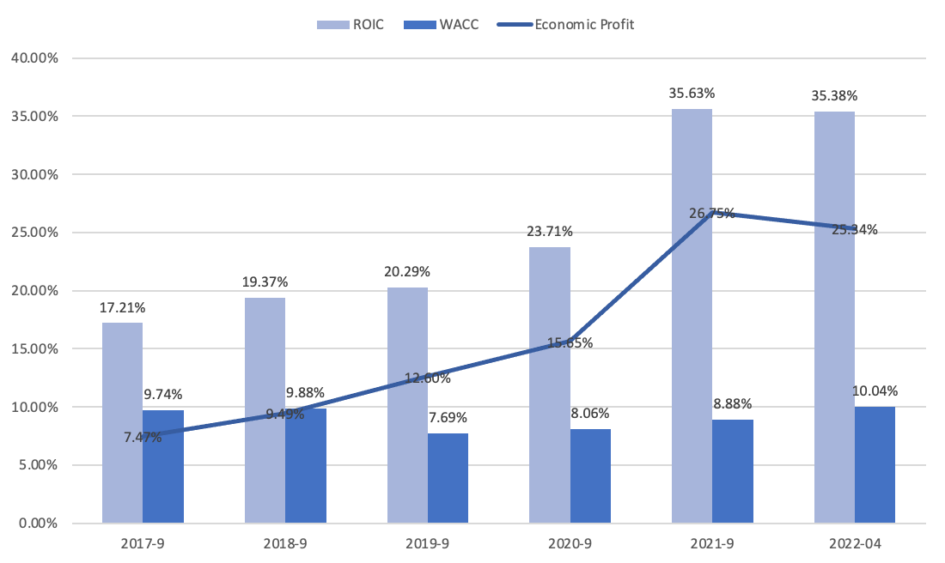
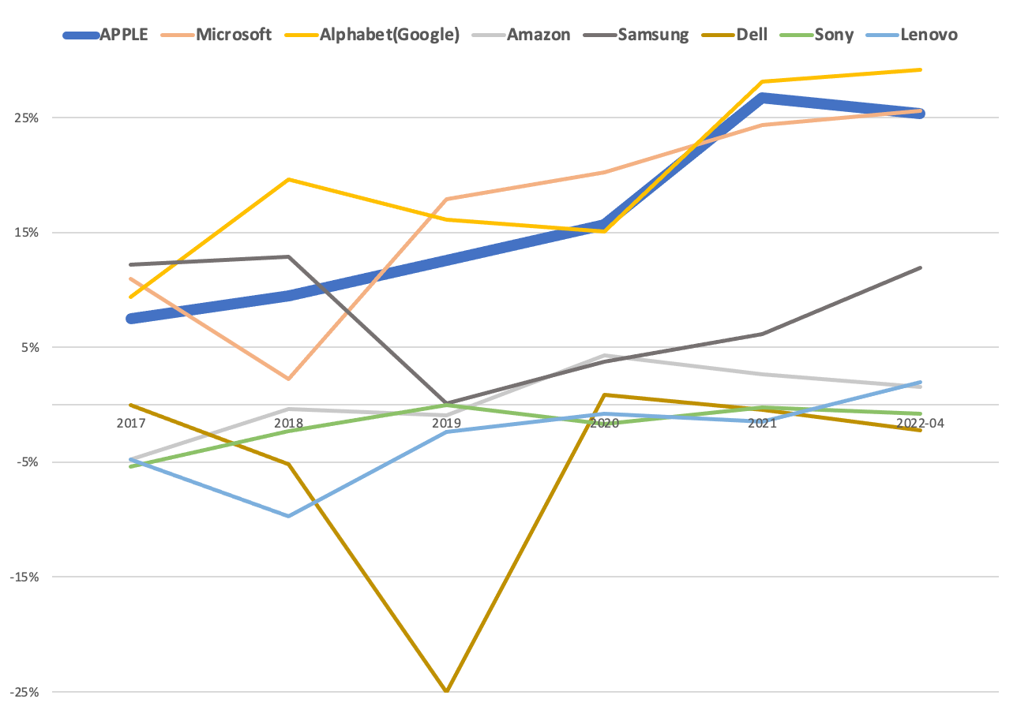
Measure of Competitive Advantage - Economic Profit
APPLE 5-year Economic Profit
APPLE & Competitors 5-year Economic Profit
Notes:
Over the past five years, apple has an increasing economic profit, most likely because apple is shifting to a service-oriented strategy to explore new market.
We expect the economic profit continue to expand.
Next please

Slide 9
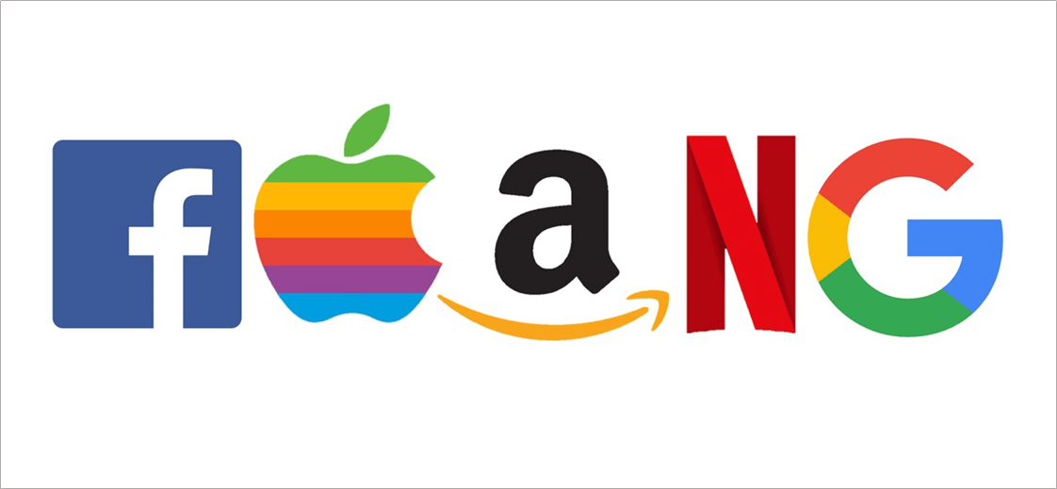
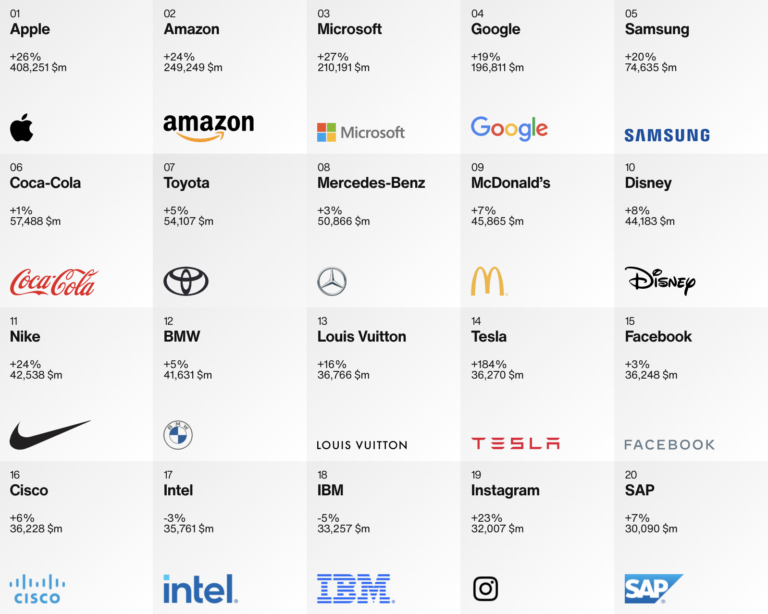
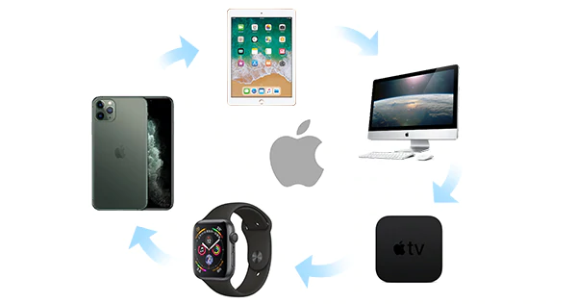
Pricing & Cost Advantages
Innovative products: 72054 patents globally
Quality:
Great in-store experience
Control of software and hardware
Game-changing tech
Safety and security
Customer Lock-in:Products share the same software and applications, and operate in a similar way
Brand:Most valuable world’s leading brand in 2021
- Brand Consultancy Firm Interbrand
Innovative Inventory Management and Low inventory turnover:
Purchases components & materials from various suppliers
Ship components to the assembling plant
Ship products to consumers
Unique resources: Ecosystem & Developer
Scalable products: Complementary products
Notes:
Let’s turn to apple’s pricing and cost advantages
Apple is consistently innovative and has more than 72 thousand patents globally
Apple has great quality in
Firstly great in-store service
Secondly control of software and hardware
Thirdly. Apple have game-changing tech
And also high security
Compare to Windows, Macbook are less likely infected by virus.
It has high level of customer Lock-in and well-known brand
The firm has innovative inventory management and low inventory turnover
The company purchases components and materials from suppliers and ship them to the assembling factory, and then ship products to consumers
The ecosystem and the related developers, programmer, designers are its unique resources
Lastly, The scalable products also rise the customers attention to buy more from apple
Next please

Slide 10
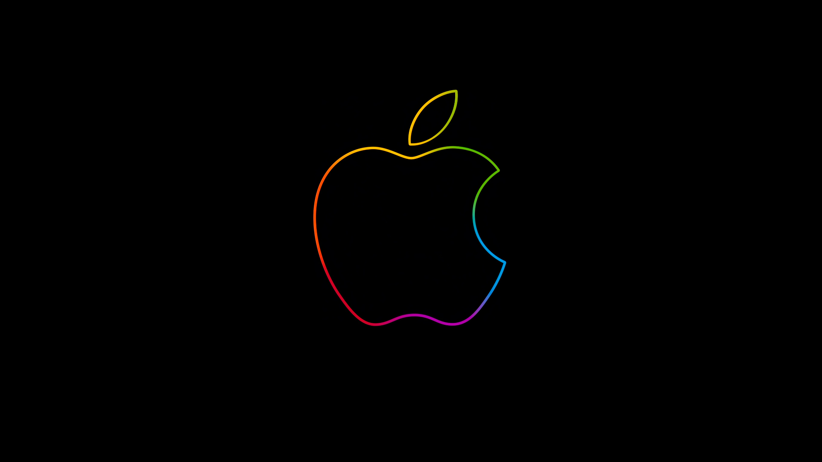
Apple’s privacy policy
Other big tech firms lost Ad revenue
Snap, Facebook, Twitter, and YouTube have lost a combined $9.85 billion in the third and fourth quarters of 2021
2021.4 - Apple released App Tracking Transparency (ATT) and limited apps' ability to track user behavior
Benefit Apple’s own App Store advertising
Apple went from capturing 17% of all sponsored app store downloads to 58% in 6 month
Apple’s services business grew 24% year over year last quarter
Notes:
Last year April
Apple released an update called “App Tracking Transparency” for iPhones to limite apps' ability to track user behavior
The policy challenges companies like Snap, Facebook and Youtube who lost Ads revenues
In contrast, the change benefits Apple’s advertising.
Less outside ads, means more room for Apple-hosted ads
Apple’s services revenue including ads and subscription, grew 24% year over year last quarter
I will pass it to Jessie

Slide 11
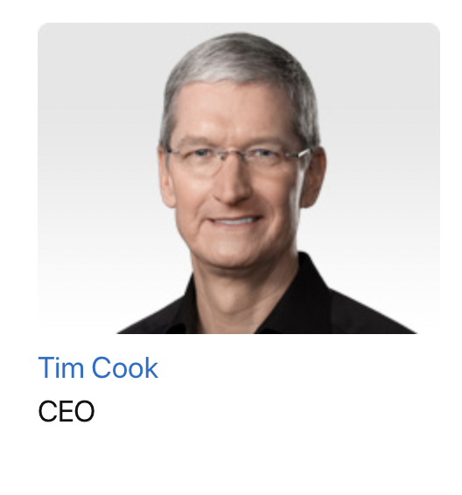
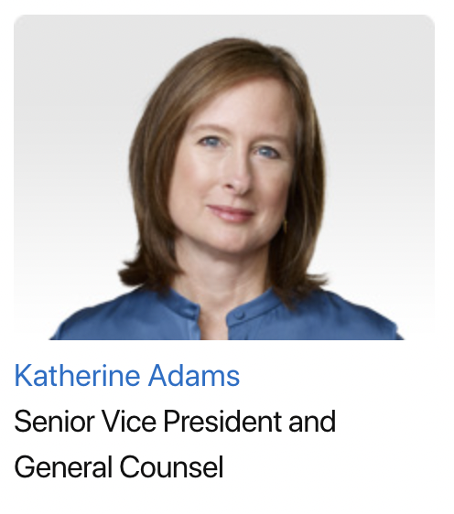
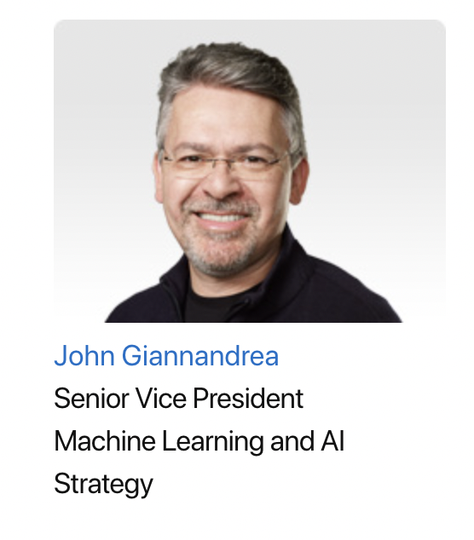



Leadership and Governance
Corporate Governance (Selected Areas)
Executive Profile
Board of Directors
Audit Committee
Compensation Committee
Nominating Committee
Board of Directors
(Source: Apple, 2022)

Slide 12
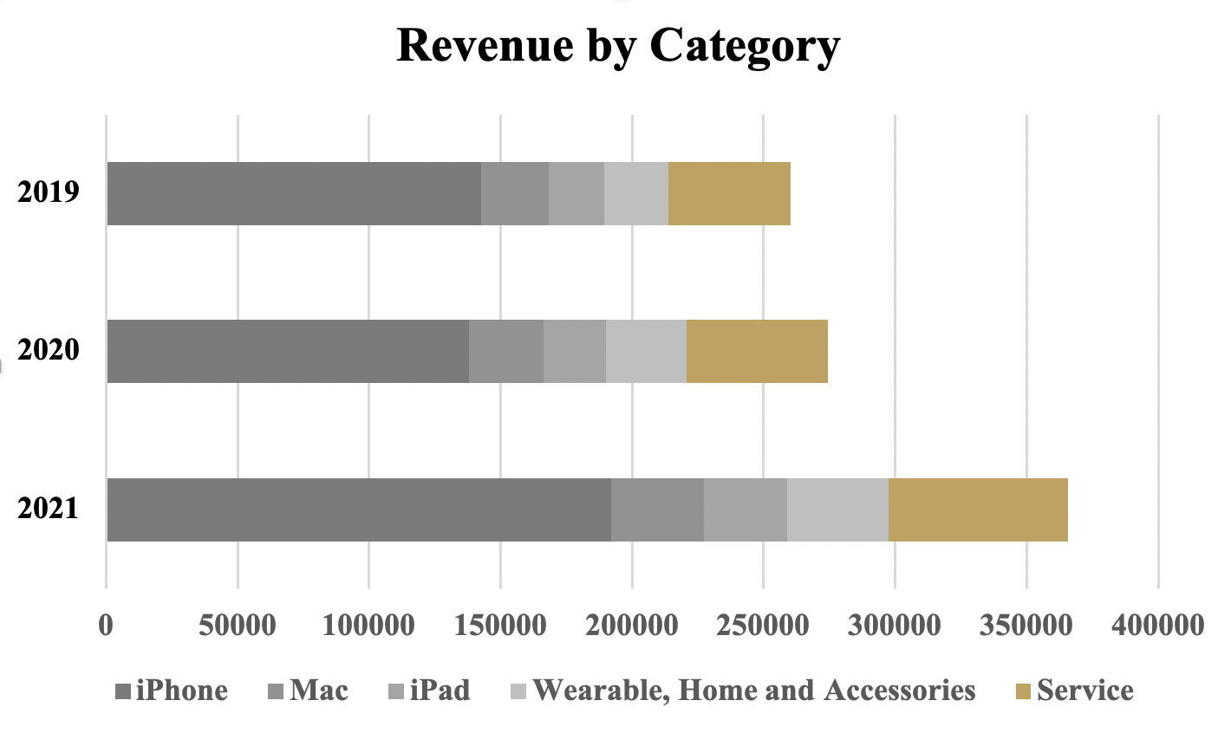
Financial Analysis - Net Sales Hits Records in 2021
Revenue from Product
Key Drivers in 2022 ~ M2 chip, Mac Pro, iMac Pro and future displays
Revenue from Service
Product Strategy Shift ~ Hardware leasing service
Major Software update ~ iOS 16
Embracing Innovation in Trends ~ New Apple Watch to gather health data

Slide 13
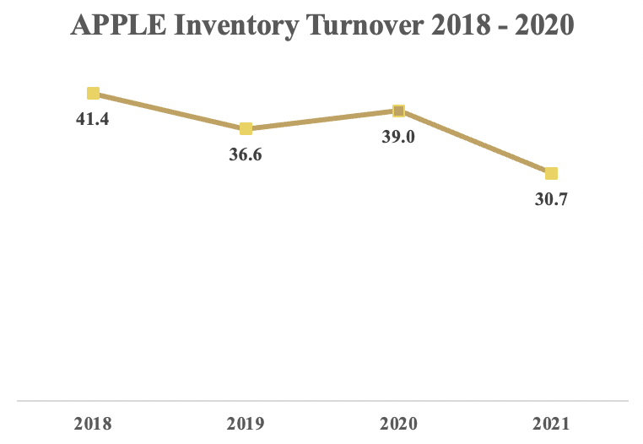
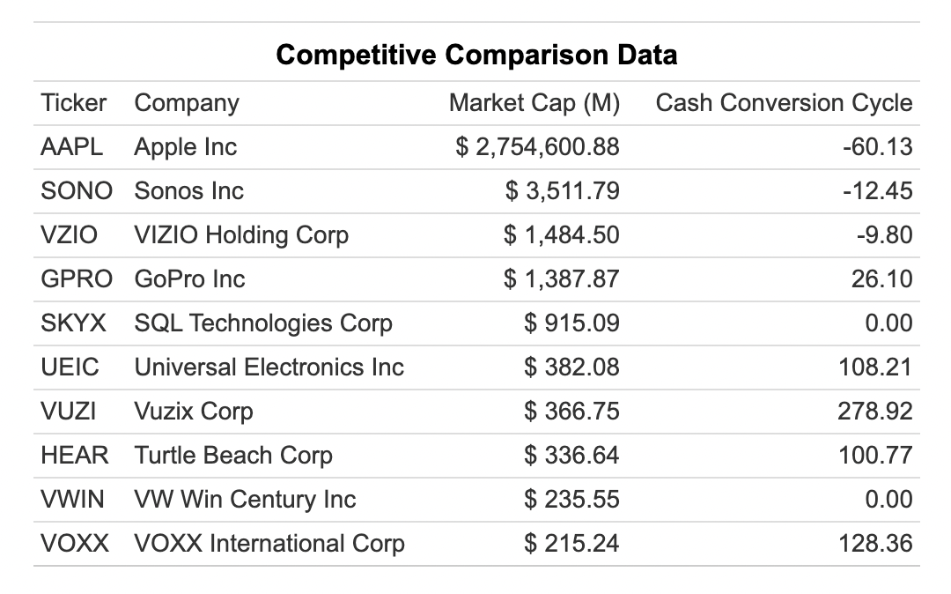
Financial Analysis - Effective Supply Chain Management
Inventory Turnover decreased from 2018 to 2021
Cash Conversion Cycle Peer Analysis
Notes:
In addition, the company is effective at its supply chain management. Apple has the ability to diversify its product without adding pressure to its supply chainis. Historical data indicates Apple has a stable and strong performance at inventory management. From 2018 to 2021, Apple’s Inventory Turnover shows a trend of decrease, and the figure has decreased from 40.1 to 30.7 in 4 years. Despite the disruption in global supply chain since the outbreak of COVID-19, Apple still managed to decrease its inventory. turnover and keep a cash conversion cycle of -60.13 days. This indicates the company has a strong bargaining power to its suppliers and has a healthy cash flow management.
However, the macroeconomic environment has posed challenge on its supply chain management with raising energy price and labor cost, which may leads to lower margin this year. China‘s zero covid policy
may also constrain the delivery of the products. Hence, what could happen is even though different types of new products are launched,, they cannot be delivered to customers in a timely manner and effectively converted to revenue.

Slide 14
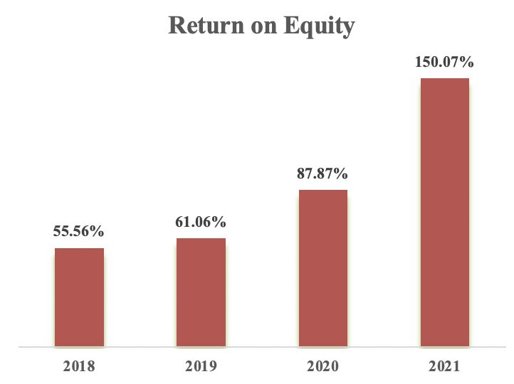
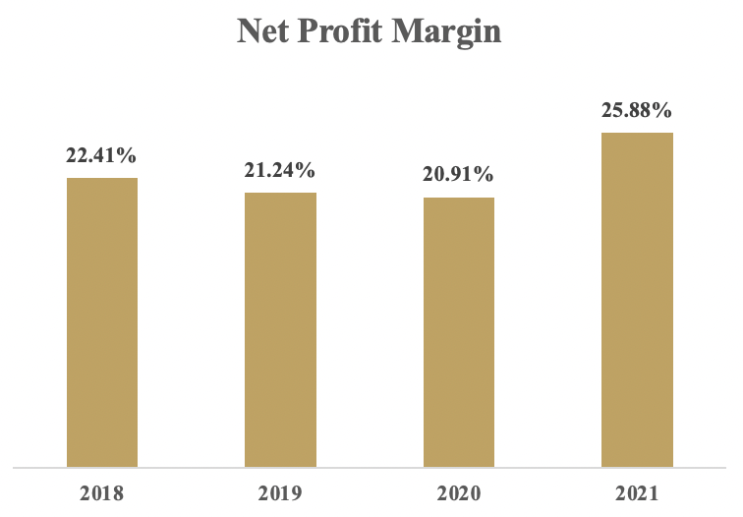
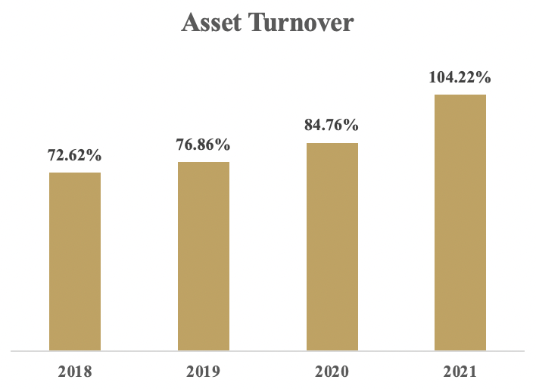
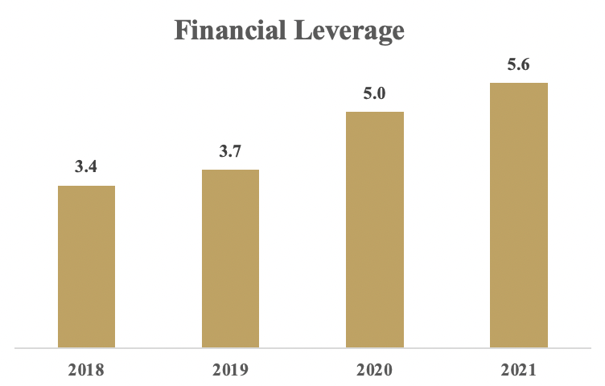
Financial Analysis - ROE
Return on Equity = Net Profit Margin * Asset Turnover * Financial Leverage
Notes:
Return on equity measure Apple’s ability to use shareholders’ fund to generate revenue. As can be seen from the graph, Apple’s Return on Equity increased significantly from 55.56% in 2018 to 150.07% in 2021. When we deposite ROE by using the formula:
ROE = Net Profit Margin * Asset Turnover * Financial Leverage
We can see from the graph that the increase in ROE was driven by the stable increase in net profit margin, asset turnover and financial leverage. This indicates Apple’s continually improvement in its bottom line.

Slide 15
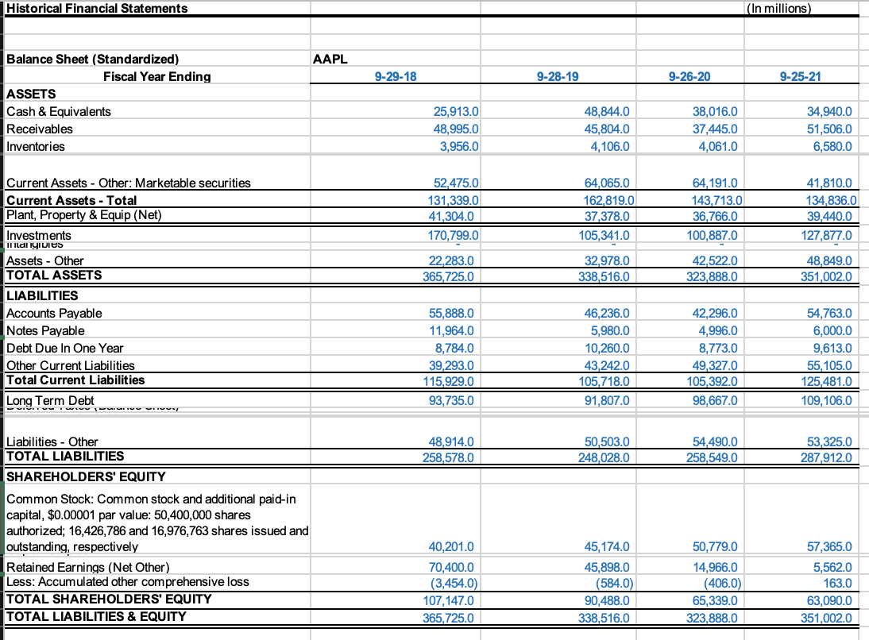
Consolidated B/S & I/S

Slide 16
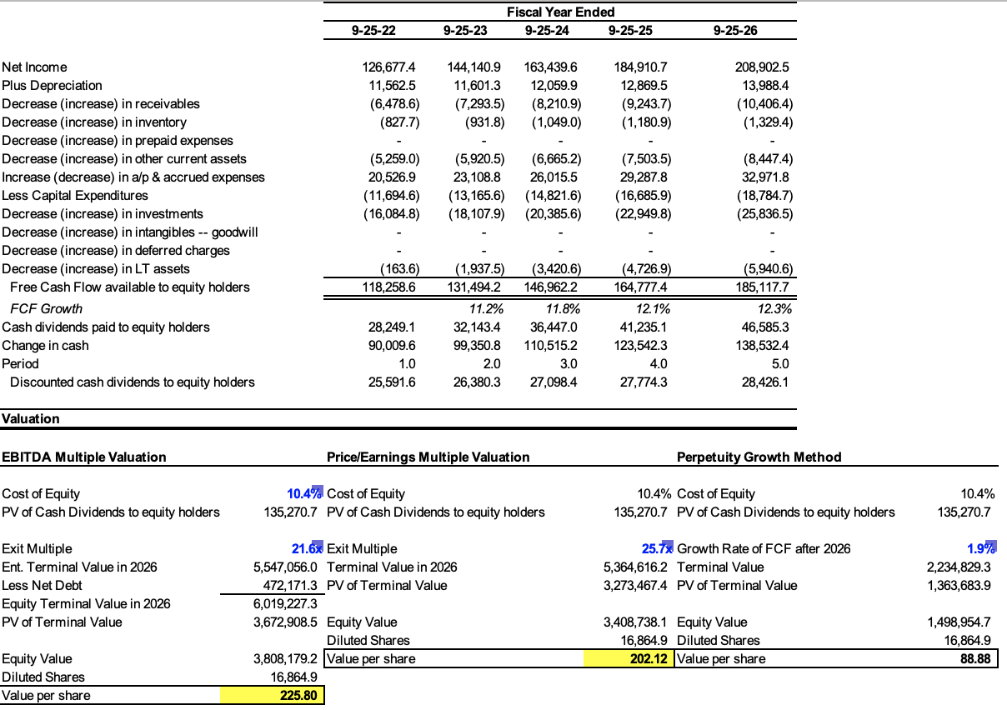
FCF Projection & Valuations

Slide 17
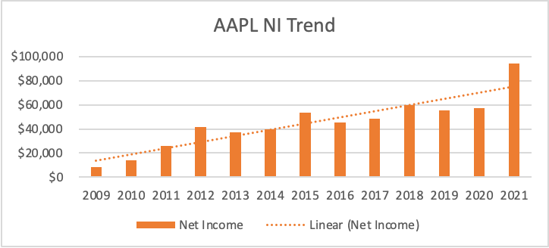
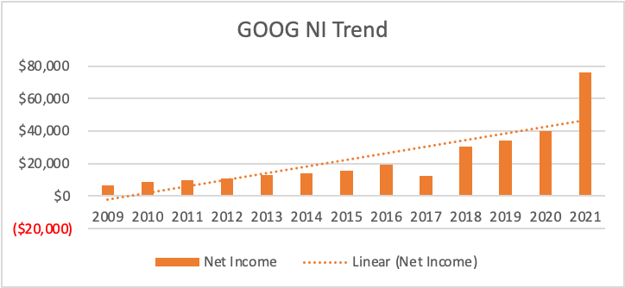
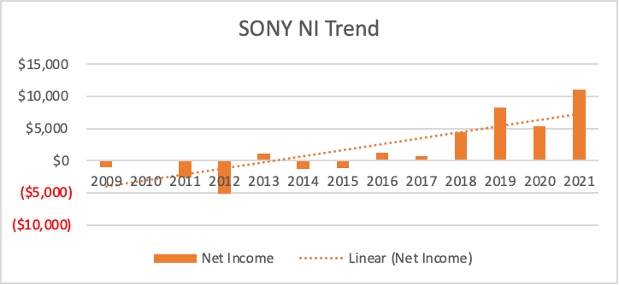
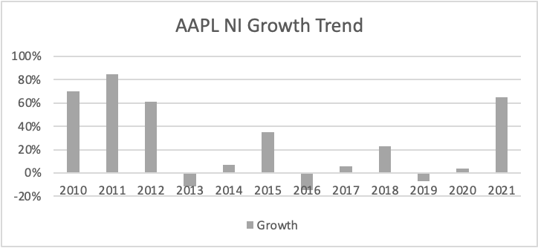
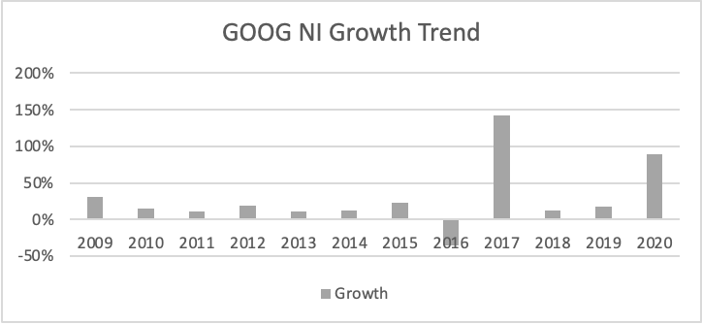
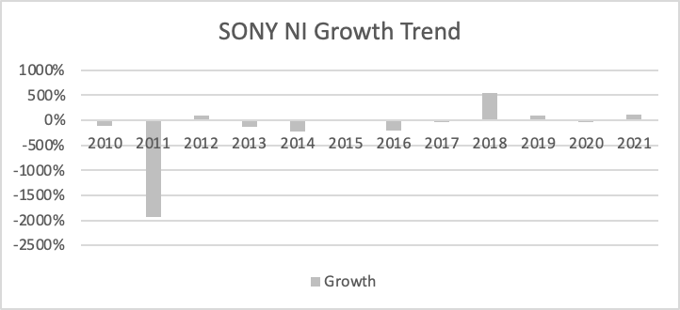
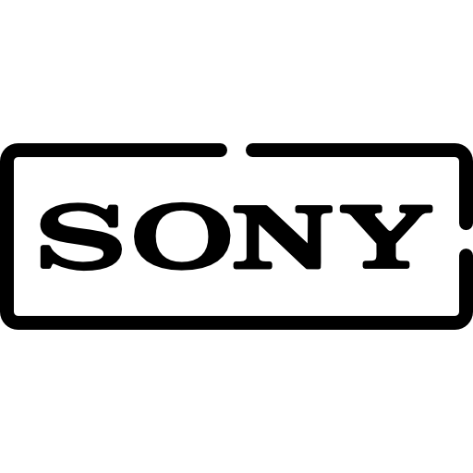
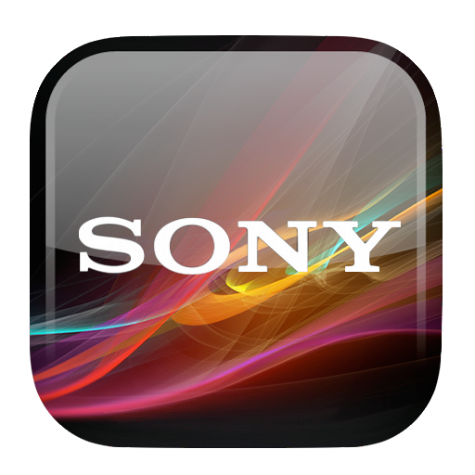
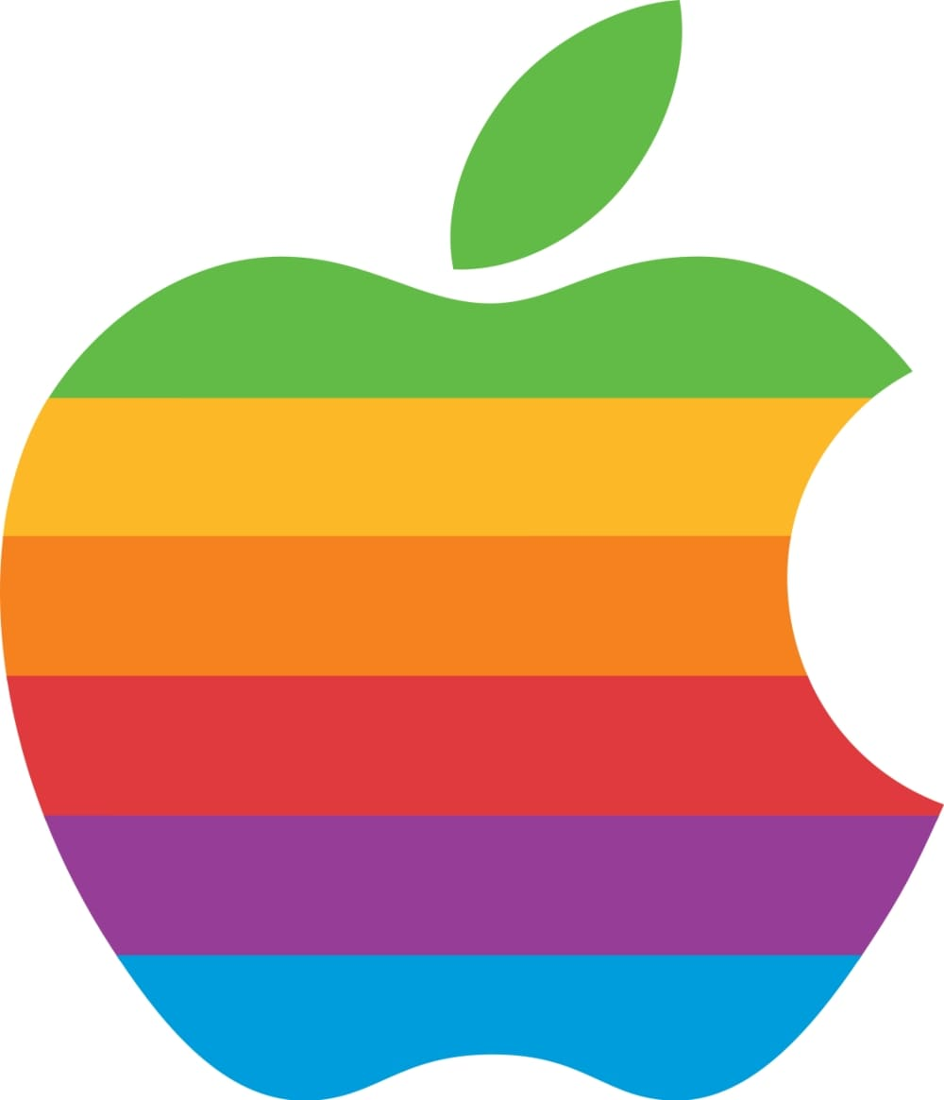


Sustainability of Earning
Notes:
Apple’s earnings in 2021FY has been the best on its record, along with one of the highest growth rates. However, it is important to note that the growth is largely driven by the reliance on digital technology during the pandemic. As shown below, Apple is not the only company that benefits from the pandemic, in fact, other tech giants from the consumer electronics industry also had the best on record earning performance in the past year, e.g. Alphabet, Sony.
In general, the trend of Apple's earning record is mostly stable over the past decade. In addition, as the analysis of competitive advantage has stated above, Apple has pricing advantages, cost advantages, and positive EVA that support it to remain profitable and stay in the “virtuous cycle”. Besides, as Factor 5 from PEST pointed out, metaverse could be the next life-changing technology that will bring immense opportunities, and Apple is certainly one of the beneficiaries for its strength in design, research, and brand premium (from SWOT). Therefore, Apple is believed to have sustainability of good earnings in the long term.

Slide 18
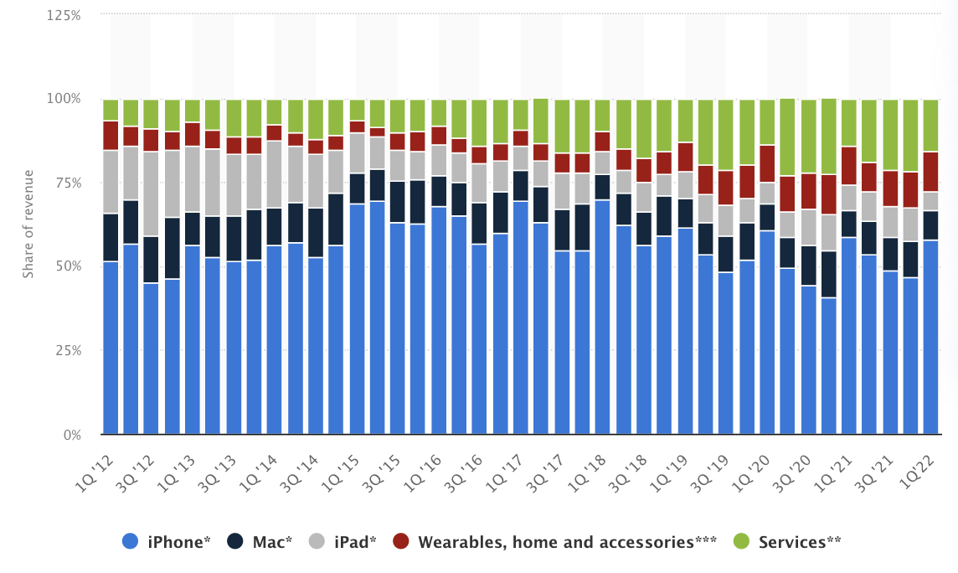
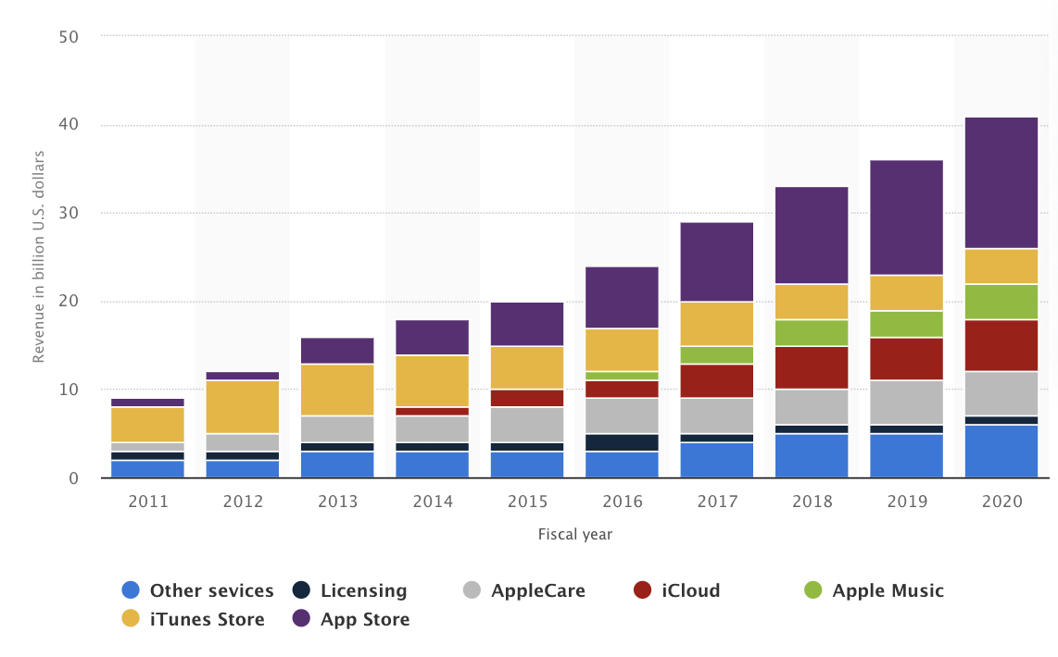
Sustainability of Earning & Transformation
“CTA expects software and digital services growth YoY slowing down from 11% to 6%, and hardware related dropping from 9% to 1.8%.”
AAPL Total Revenue Breakdown
AAPL Service Revenue Breakdown
Notes:
In 2021, Consumer Technology Association remarked that there had been “unprecedented demand” for tech goods related to work and lifestyle, but CTA expects software and digital services growth YoY slowing down from 11% to 6%, and hardware related dropping from 9% to 1.8%. Unfortunately, Apple’s revenue largely depends on hardware sales, the breakdown is shown here. Furthermore, combined with Factor1 from PEST analysis, the supply chain remains susceptible. In other words, in the short run, Apple's outstanding earnings performance from 2021FY may not persist.
Transform into a service company is a way to relax from the growing competition and saturation of the hardware market and there’s a lot more room for market growth imagination by exploiting the possibilities of the IOS ecosystem.

Slide 19
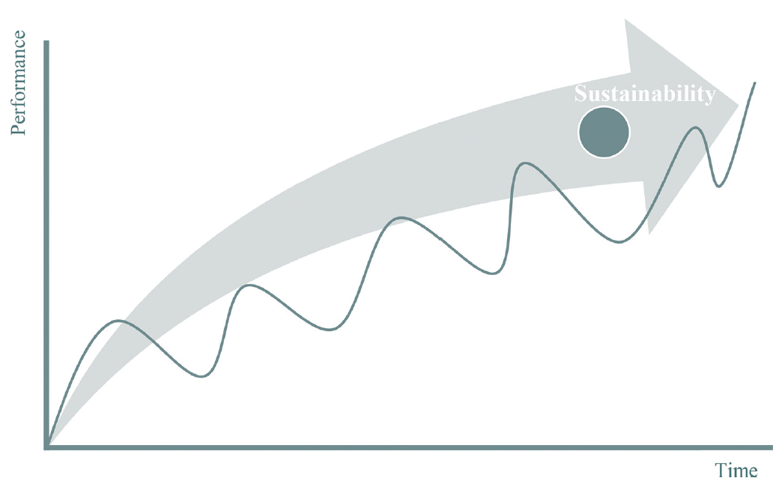
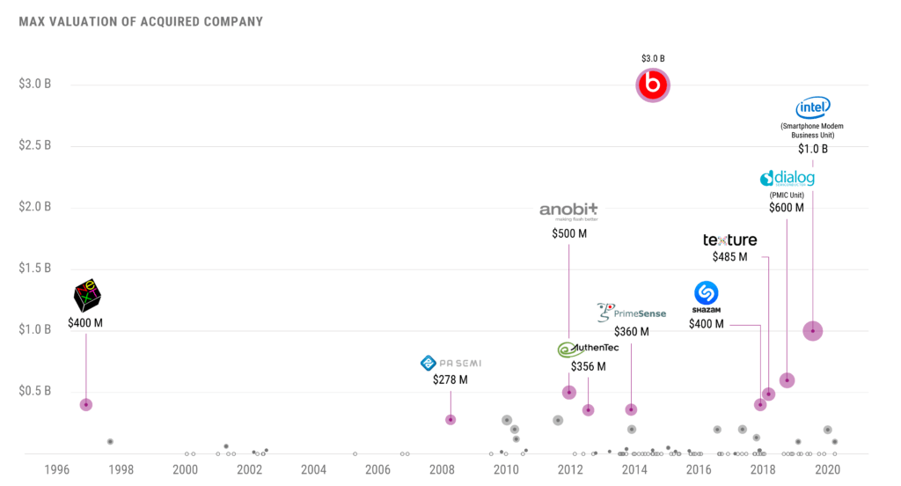
Sustainability - Can Apple fail?
Entrepreneurship Failure? What if Tim Cook leaves?
Managerial Failure? Are there too many M&A?
Social Failure?
Or a Total Failure like Kodak?
Apple is in a “Virtuous Cycle”!
Notes:
Apple doesn’t rely on anyone anymore, it relies on its ecosystem, the integration of hardware and software. It doesn’t rely on blockbusters or a single entrepreneur.
Unlike Dell and Cisco, there are barely any strategic M&A recently, the biggest one was beats from 2014 with 3 billion. Most of the M&A are small size.
3. I think tech giants today are very careful about their social influence.
4. No, Apple is innovative, and it has strong enough moats to stay unique.

Slide 20

Investment Recommendation - Buy
Valuation => Undervalued
Earning => Unsustainable in the short run
=> Sustainable in the long run
Competitive Adv. =>
Fin Stmt Analysis => Strong fundamentals
Sustainability =>
Other perspectives => Mostly beneficial
Notes:
In 2021, Consumer Technology Association remarked that there had been “unprecedented demand” for tech goods related to work and lifestyle, but CTA expects software and digital services growth YoY slowing down from 11% to 6%, and hardware related dropping from 9% to 1.8%. Unfortunately, Apple’s revenue largely depends on hardware sales, the breakdown is shown here. Furthermore, combined with Factor1 from PEST analysis, the supply chain remains susceptible. In other words, in the short run, Apple's outstanding earnings performance from 2021FY may not persist.

Slide 21

References
https://www.investopedia.com/articles/investing/111015/analyzing-porters-five-forces-apple.asp
http://panmore.com/apple-inc-five-forces-analysis-porters-model-case-study
https://www.gurufocus.com/term/wacc/AAPL/WACC-Percentage/Apple
https://www.morningstar.com/
https://www.financecharts.com/
https://www.investopedia.com/articles/08/recession.asp
https://www.barrons.com/articles/stocks-built-for-inflation-51649202855
https://moneyweek.com/economy/us-economy/604070/us-federal-reserve-tapering-qe
https://www.npd.com/news/press-releases/2022/us-consumer-technology-revenue-sales-end-2021-up-9-following-double-digit-growth-in-2020/
https://www.forbes.com/sites/sergeiklebnikov/2022/03/15/most-wall-street-experts-now-predict-stagflation-heres-what-that-means-for-investors-and-the-us-economy/?sh=2324a8d01400
https://www.hardsoftcomputers.co.uk/blog/apple/why-is-apple-associated-with-high-business-productivity/
https://appleinsider.com/articles/21/10/29/apple-has-most-loyal-smartphone-customers-in-us-study-finds
https://www.digitaltrends.com/mobile/apple-widest-range-of-products-2022/
https://insights.greyb.com/apple-patents/#:~:text=Apple%20has%20a%20total%20of,patents%2C%2055757%20patents%20are%20active.
https://interbrand.com/best-brands/
https://www.tradegecko.com/blog/supply-chain-management/apple-the-best-supply-chain-in-the-world#:~:text=Looking%20back%20at%20the%20last,as%20possible%20is%20very%20important.
https://www.upscalelivingmag.com/what-makes-apple-products-such-high-quality/
https://www.emarketer.com/content/apple-ad-revenues-skyrocket-amid-its-privacy-changes
Q&A
Thanks You!!
Notes:
https://investor.apple.com/sec-filings/sec-filings-details/default.aspx?FilingId=15467181

